Slide 1
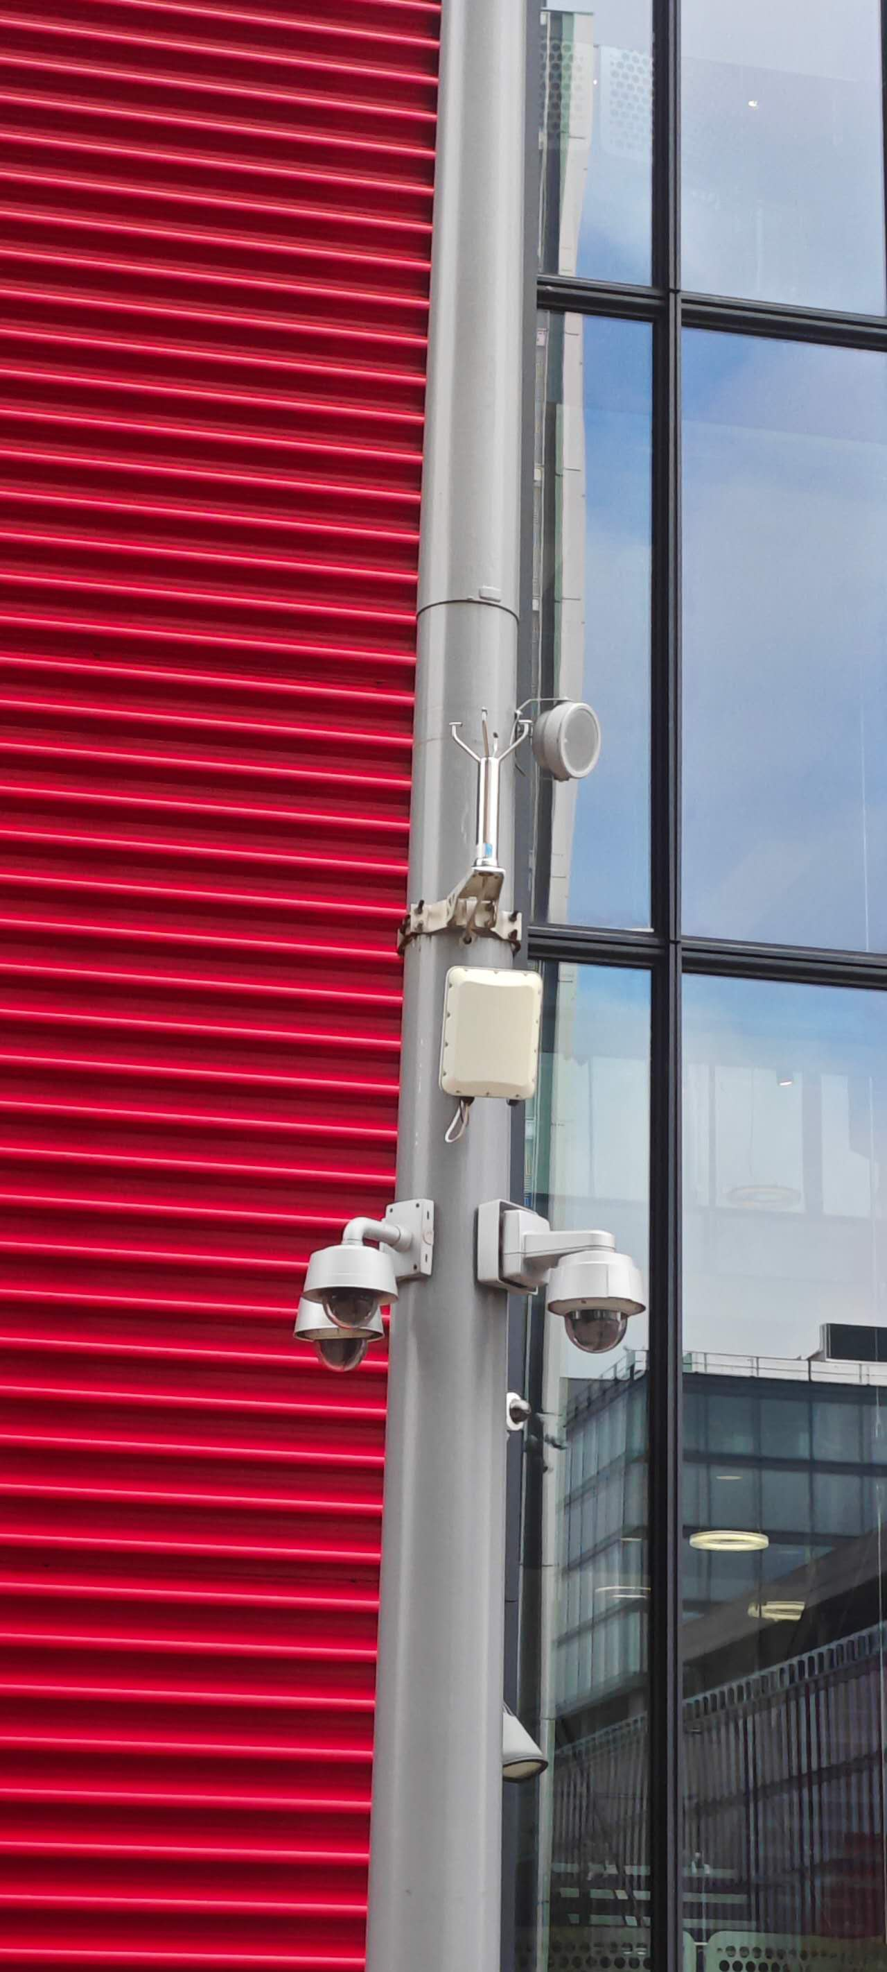
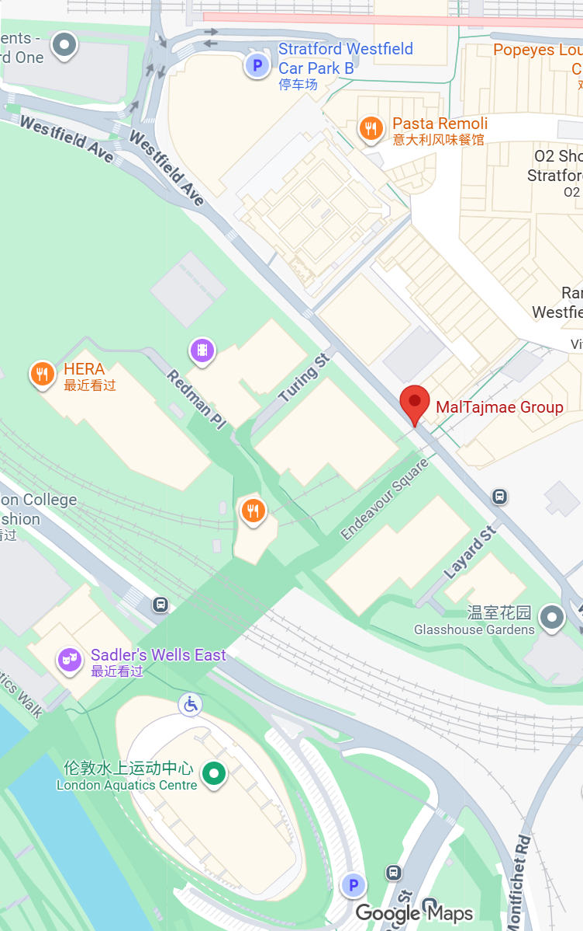
the little white box may be a wireless transmitter/receiver or a data collection unit
The little white box may be use to gathering environmental data or serving as a communication hub. it may used to support the operation and connectivity of cameras or other sensors like environmental sensor
or sensor that used to count population of this street, or it is used as a wifi connection.
Questions when visiting site?
what’s the real function of this vehicle.
Why is such a device set up here?
What is its power supply method? Is it battery-powered, solar-powered or connected to a cable?
Location info:
@51.542283, -0.008425
61 Westfield Ave, London E20 1EH
https://maps.app.goo.gl/ZbMScXawqYkUeG478
Submitted: Jiahua He Oct 2025
Notes:
A title and a couple of sentences describing the technology and possibly linking to further information online.
A photo of the technology in situ with a corresponding map showing where it is.
2 or 3 questions that you might ask when you are in situ at the site of the technology to engage others in a discussion about that technology
The following geographic data:
Lat Long
Street Address
Google maps link
What3words location
Also add in the names of those submitting this data.

